Slide 1
Evaluating model performance

Slide 2
Measuring performance for classification
Actual values
Predicted values
Estimated probability of the prediction (Score)
Use Ch10.txt
Provide the path to your csv file
Head() gives the first few rows of a matrix or data frame.
Subset()

Slide 3
Notice the tables
Probabilities are extremely high or low when prediction is accurate
Probabilities are less extreme when prediction is wrong

Slide 4
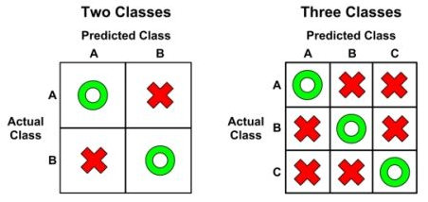
Confusion matrix
It is a table that categorizes predictions according to whether they match the actual value in the data.

Slide 5
What is positive outcome?
Choice of positive and negative is arbitrary.
Typically, rare events are taken as positive.
Rare events such as:
Having a disease
Fraudulent transaction
Prospect responding to a promotion
SMS as spam

Slide 6
Confusion matrix tabulates:
True Positive (TP): Correctly classified as the class of interest
True Negative (TN): Correctly classified as not the class of interest
False Positive (FP): Incorrectly classified as the class of interest
False Negative (FN): Incorrectly classified as not the class of interest

Slide 7
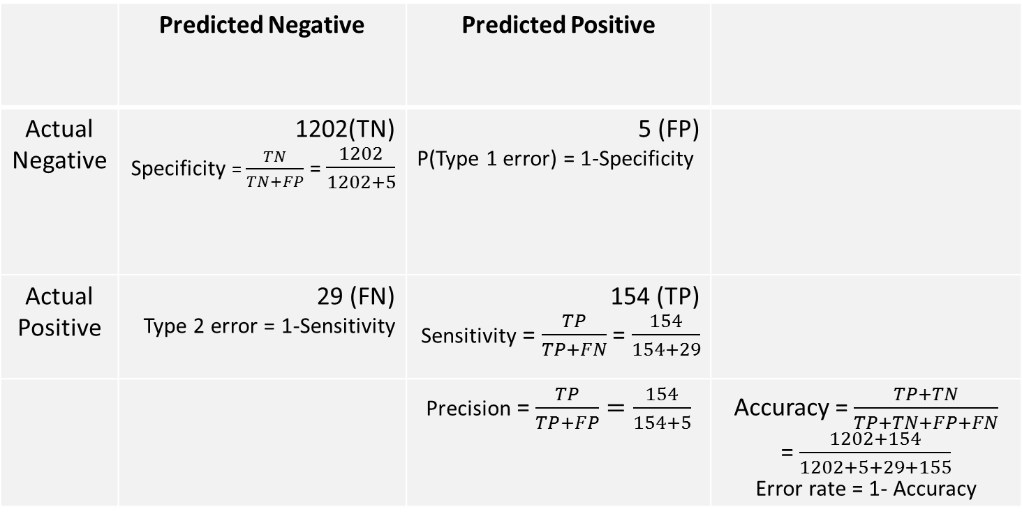
 | Predicted Negative | Predicted Positive
Actual Negative | (TN) Specificity = = | 5 (FP) P(Type 1 error) = 1-Specificity
Actual Positive | 29 (FN) Type 2 error = 1-Sensitivity | 154 (TP) Sensitivity = =
 |  | Precision = | Accuracy = = Error rate = 1- Accuracy
Specificity is also known as true-negative rate.
Sensitivity is also called true-positive rate and power of a test. In information retrieval domain, it is also called Recall.
Precision is also known as positive predictive value.
Type 1 error (α) is like “crying wolf” when there is none. In regression models, it is significance level, ie probability of seeing a non-zero coefficient when the coefficient is zero, ie probability that null hypothesis is false when null hypothesis is true.
Type 2 error (β) is like “missed detection” when there is a problem.

Slide 8
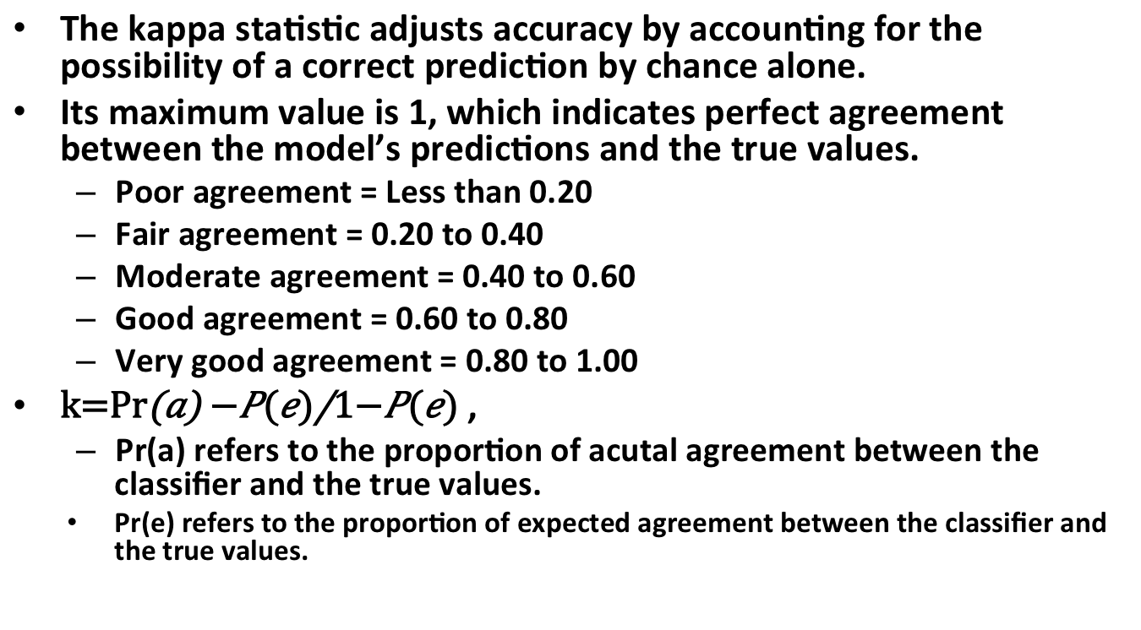
kappa statistic
The kappa statistic adjusts accuracy by accounting for the possibility of a correct prediction by chance alone.
Its maximum value is 1, which indicates perfect agreement between the model’s predictions and the true values.
Poor agreement = Less than 0.20
Fair agreement = 0.20 to 0.40
Moderate agreement = 0.40 to 0.60
Good agreement = 0.60 to 0.80
Very good agreement = 0.80 to 1.00
,
Pr(a) refers to the proportion of acutal agreement between the classifier and the true values.
Pr(e) refers to the proportion of expected agreement between the classifier and the true values.

Slide 9
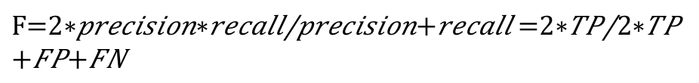
F-measure (aka F1 score or F-score)
It is a measure of model performance that combines precision and recall into a single number.
F-measure combines precision and recall using the harmonic mean.
Reduces model performance to a single number
Assumes that equal weight should be assigned to precision and recall.

Slide 10
Another way of dividing datasets
Random sampling
Create a vector of randomly ordered row IDs from 1 to 1000.
Use these IDs to divide the data frame
Problem: Partitions may have a larger or smaller proportion of some classes
Stratified random sampling
ensures that the generated random partitions have approximately the same proportion of each class as the full dataset.
createDataPartition() creates partitions based on stratified holdout sampling.
1st parameter is target variable
p specifies the proportion of instances to be included in the partition
list=False prevents the result from being stored in list format
Use the output vector to partition data frames.

Slide 11
Problems with stratified sampling
Although it distributes the classes evenly, some samples may have too many or too few difficult cases, easy-to-predict cases, or outliers. This is especially true for smaller datasets, which may not have a large enough portion of such cases to divide among training and test sets.
In addition to potentially biased samples, another problem with the holdout method is that substantial portions of data must be reserved for testing and validating the model.

Slide 12
Cross-validation
K-fold cross-validation is based of repeated holdout technique
It uses the average result form several random holdout samples to evaluate a model’s performance.
Rather than taking repeated sample that can use the same record more than once, k-fold CV randomly divides the data into k random partitions call folds.
Empirical evidence suggests that k=10 gives good results.
For each of 10 folds (each comprising 10 percent of total data), a model is trained on remaining 90 percent of data.
The fold’s matching 10 percent is then used for model evaluation.
Finally, the average performance across all folds is reported.

Slide 13
Cross-validation (cntd.)
createFolds() in the caret package can be used.
It will attempt to maintain the same class balance in each of the folds as in the original dataset.
It returns a list of vectors storing the row numbers for each of the k=10 requested folds.
To create training and test datasets, we use vectors of various folds (10 times for k=10)
performance measures are averaged to obtain the overall performance.

Slide 14
Bootstrap sampling
A slightly less popular, but still fairly widely used alternative to k-fold CV is known as bootstrap sampling, the bootstrap, or bootstrapping.
It allows a record to be selected multiple times through a process of sampling with replacement.
In dataset of n records, it randomly draws n records with replacement.
Test datasets are then constructed from the records that were not selected for the respective training datasets.
Prob. of any record getting included at least once is ~ 63.2%
In contrast, CV uses 90% of records for training and a record can appear only once.
Advantage: It works better with very small datasets.

